Slide 1
Module-4 NETWORK LAYER

Slide 3
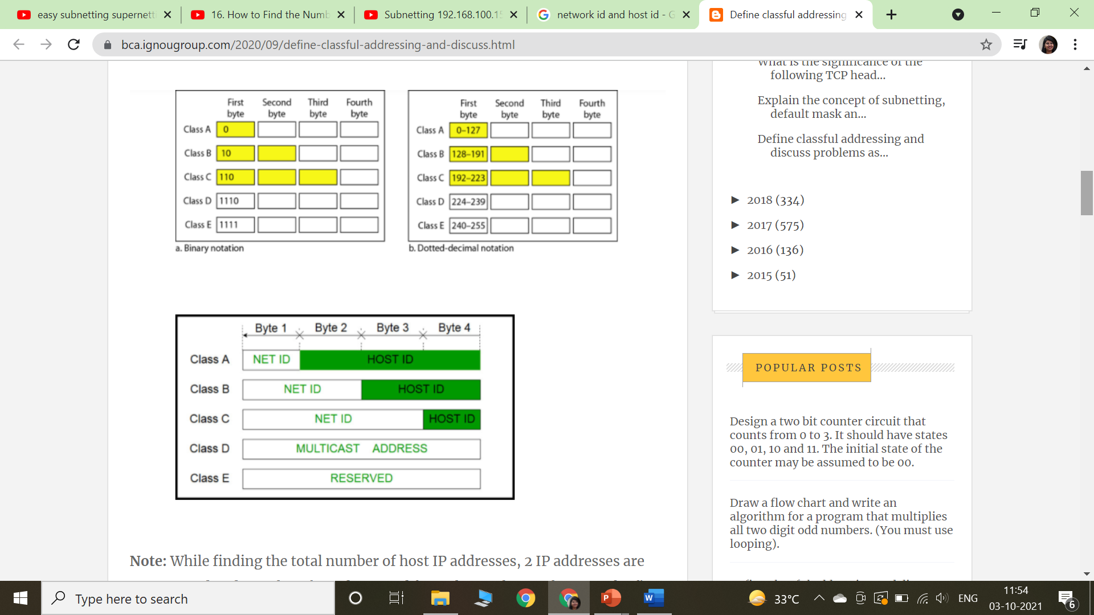

Slide 17
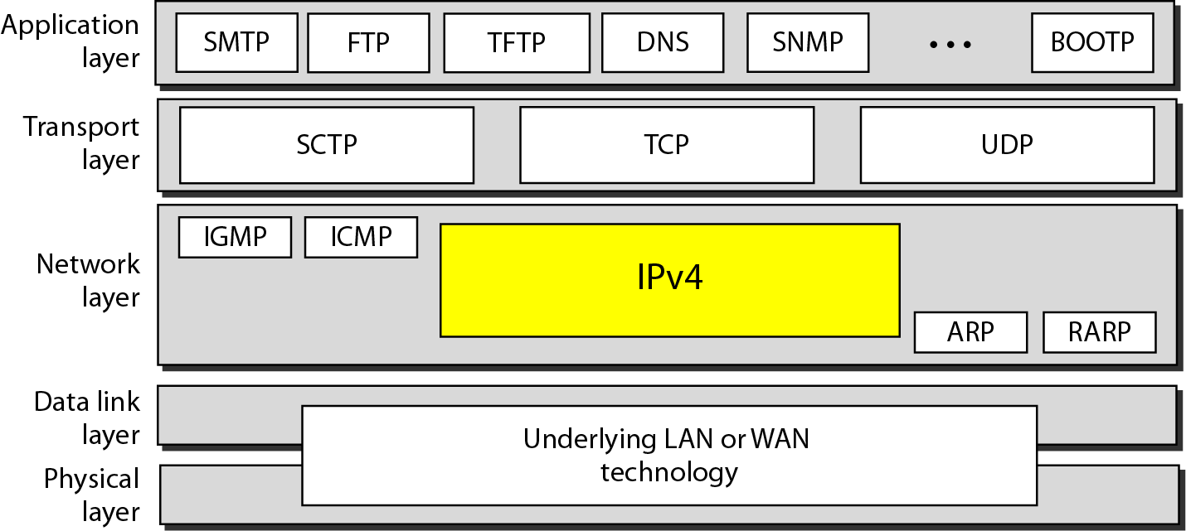
IPV4 Protocol
The Internet Protocol version 4 (IPv4) is the delivery mechanism used by the TCP/IP protocols.
Position of IPv4 in TCP/IP protocol suite

Slide 18
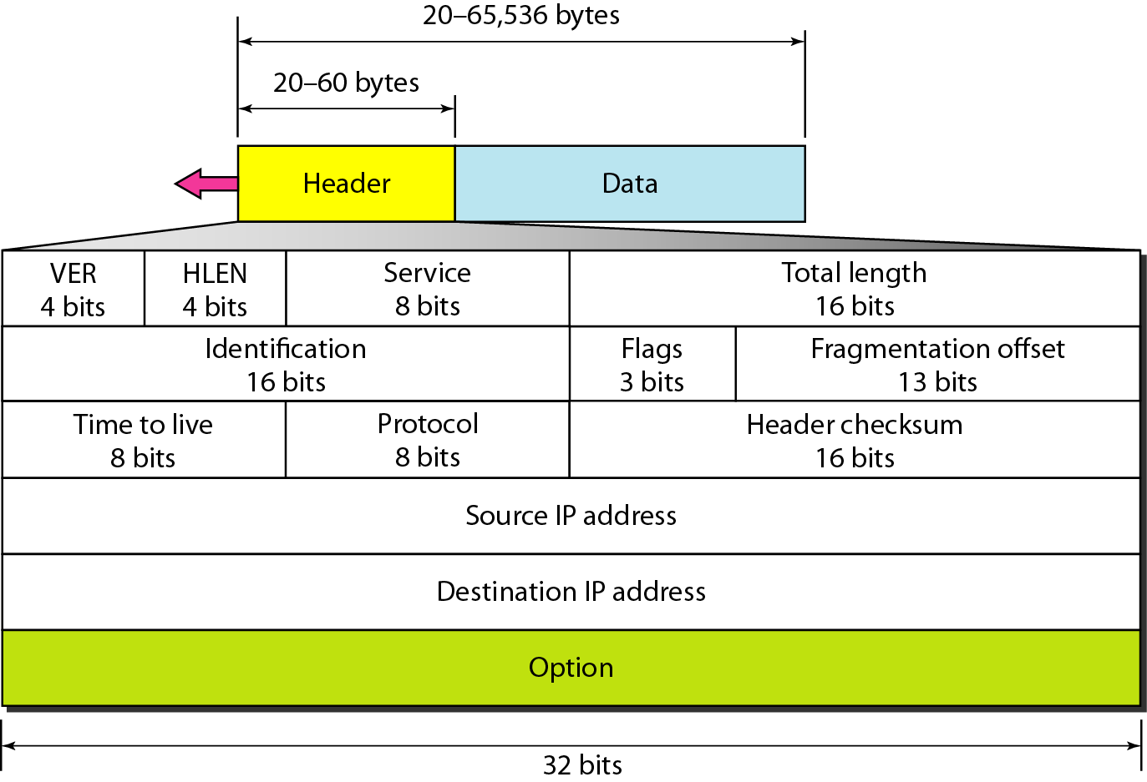
IPV4 Header
Figure 20.5 IPv4 datagram format

Slide 19
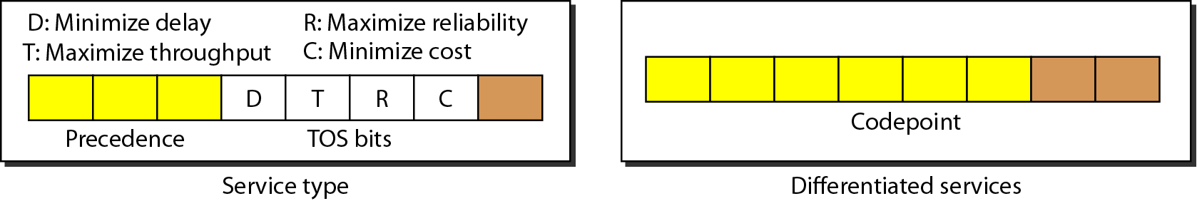
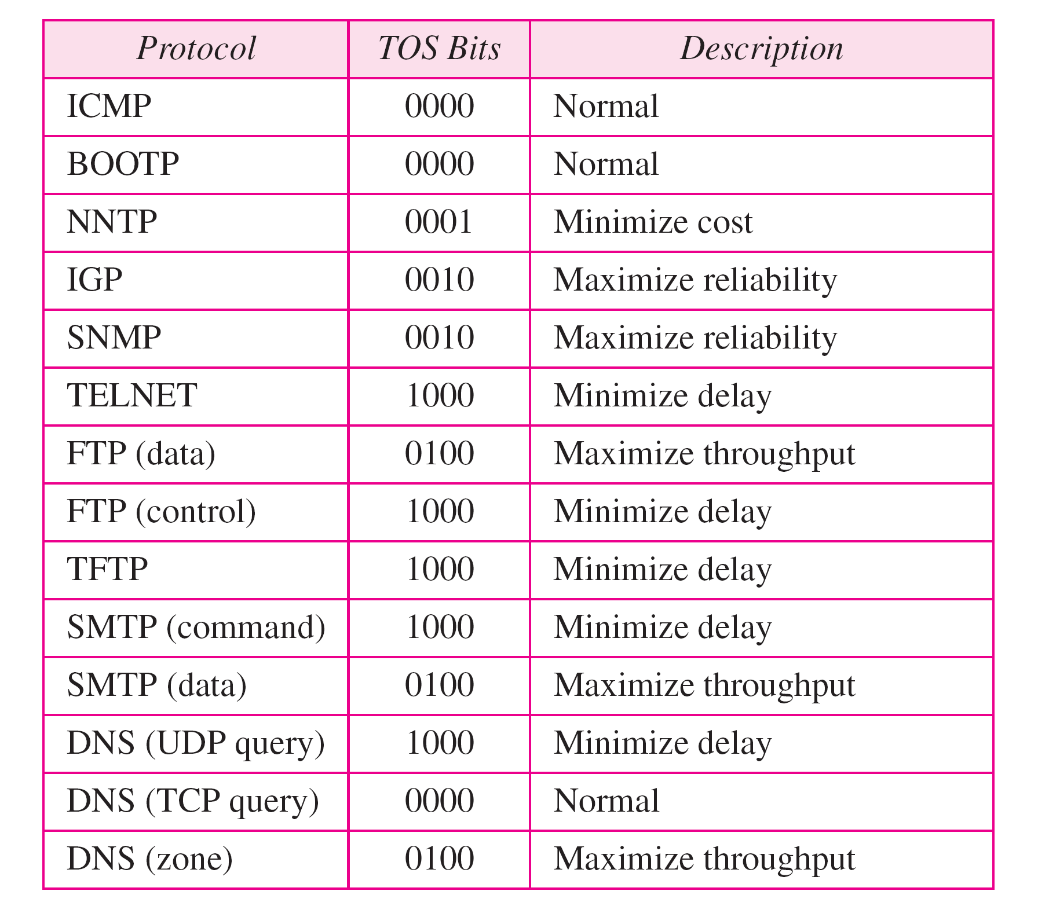
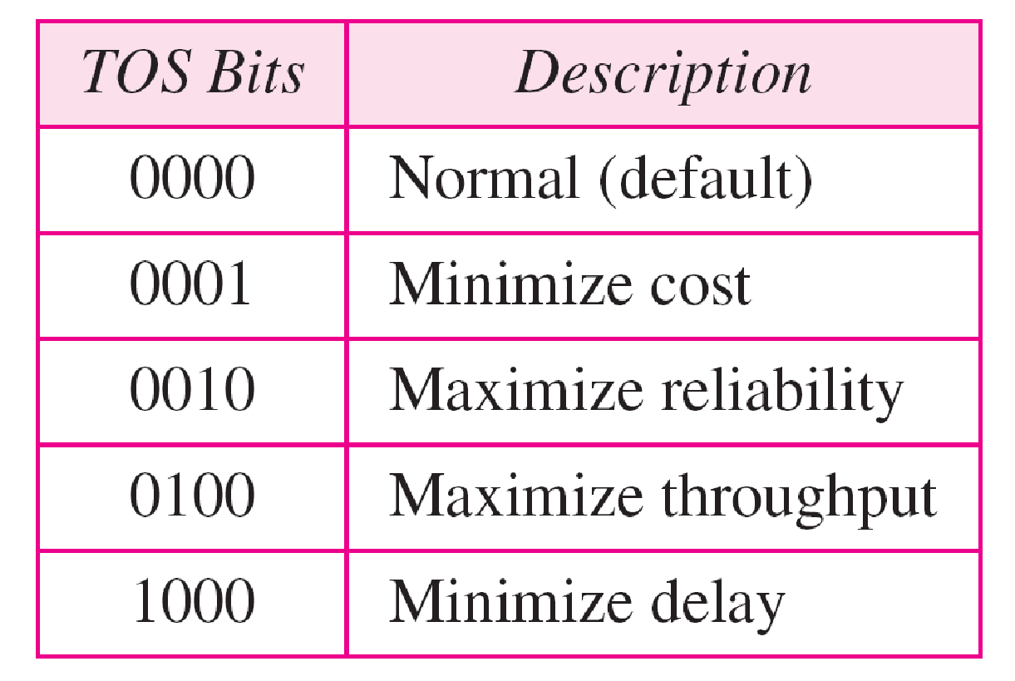
Service type or differentiated services
Types of service
Default types of service

Slide 20
IPV6 address
Despite all short-term solutions, address depletion is still a long-term problem for the Internet.
This and other problems in the IP protocol itself have been the motivation for IPv6.
An IPv6 address is 128 bits long.

Slide 21
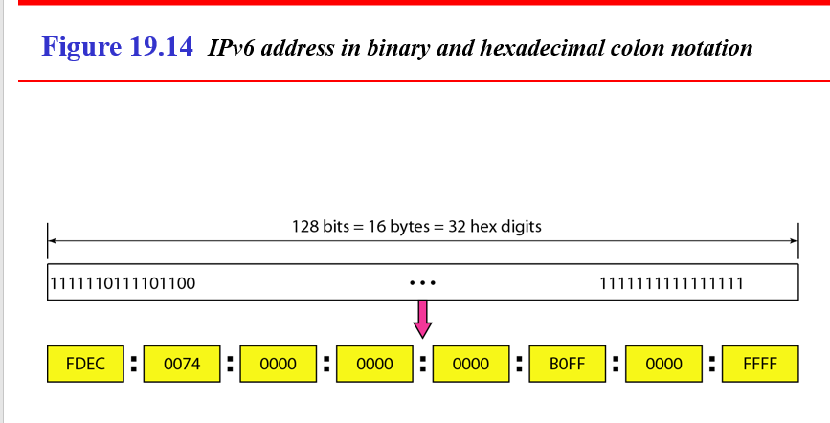

Slide 22
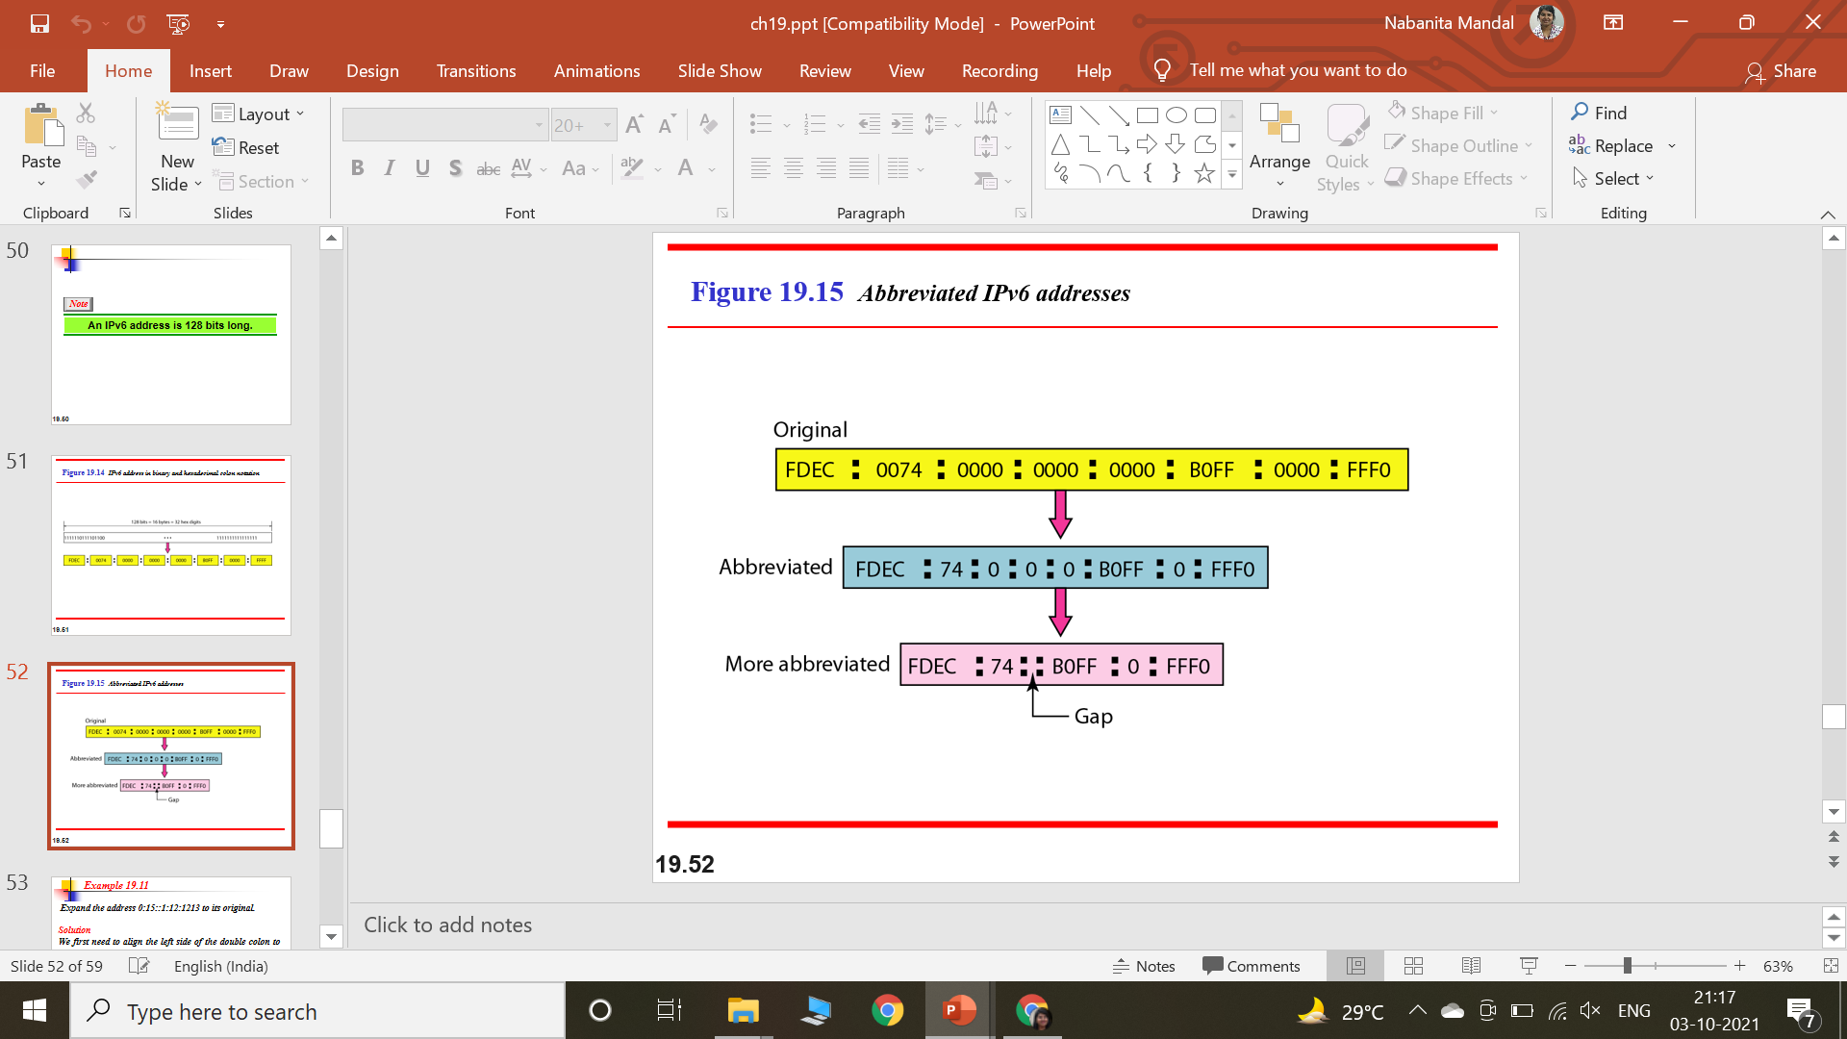

Slide 23
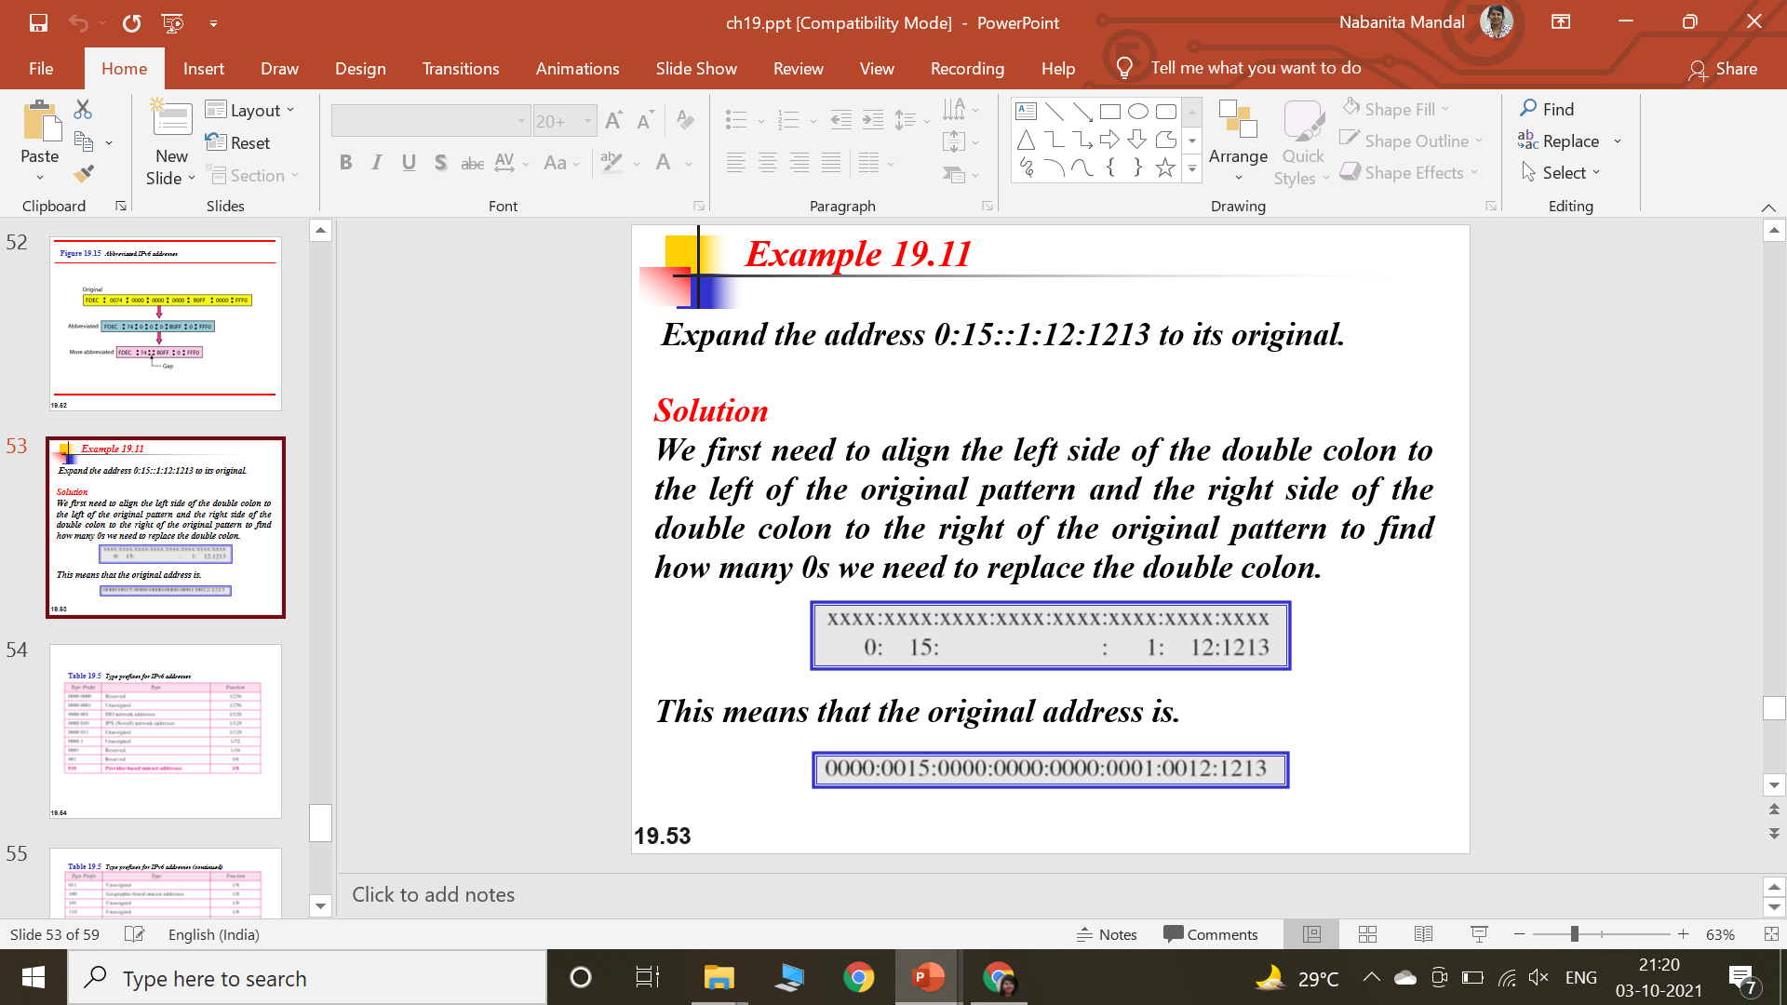

Slide 24
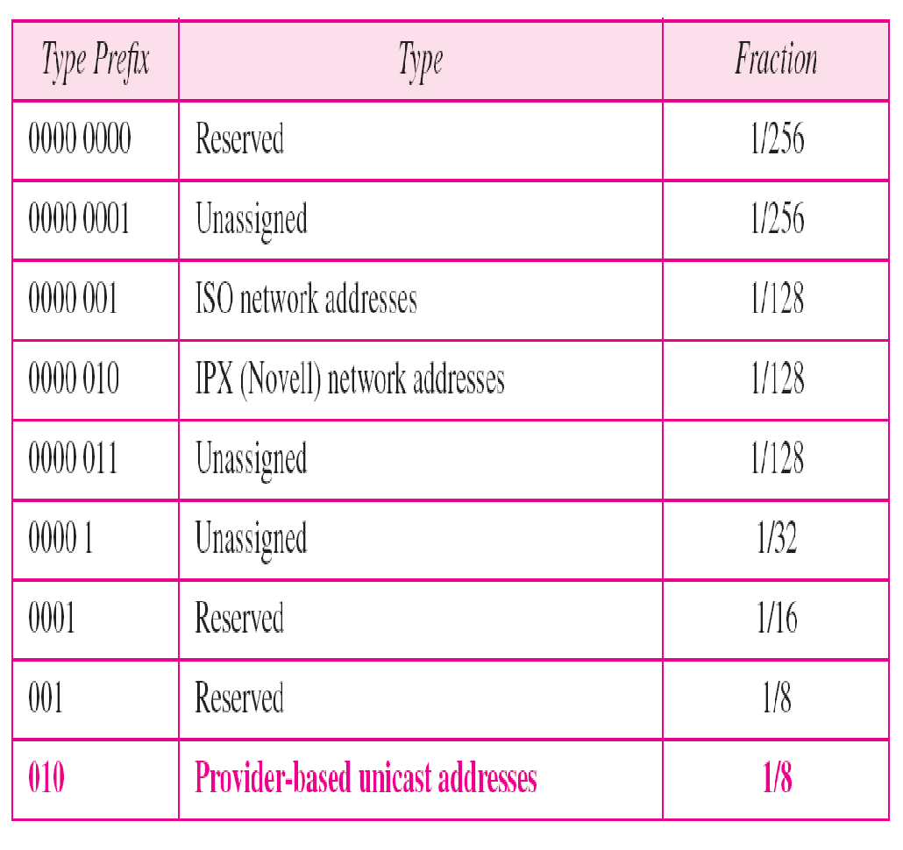
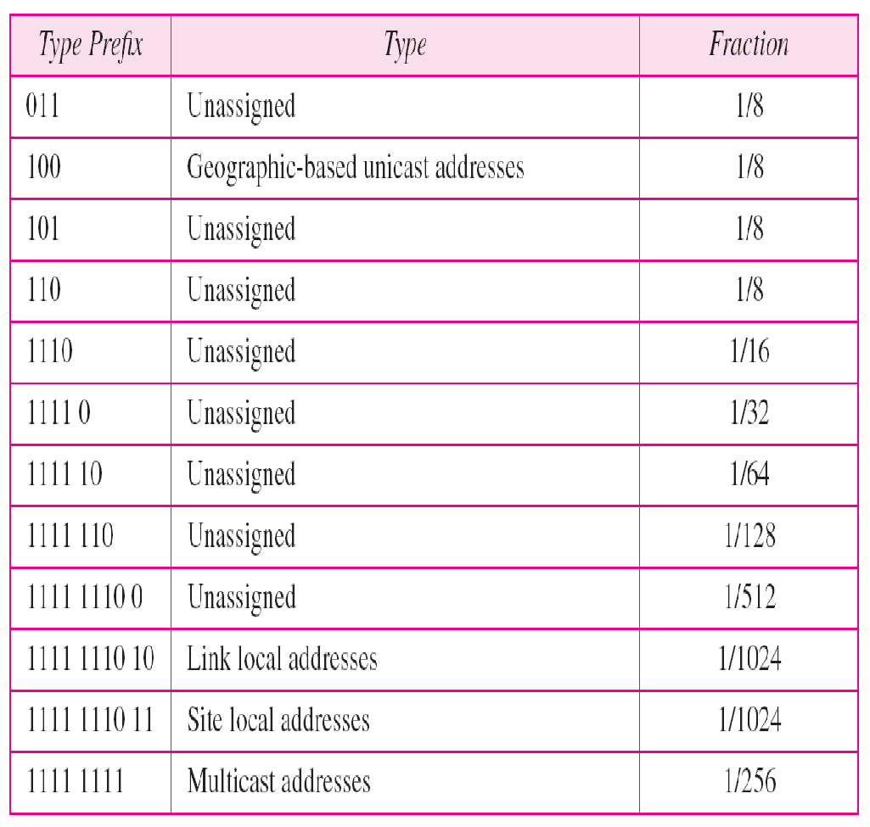
Table 19.5 Type prefixes for IPv6 addresses

Slide 25
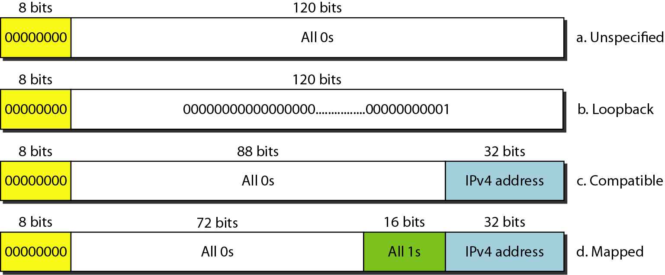
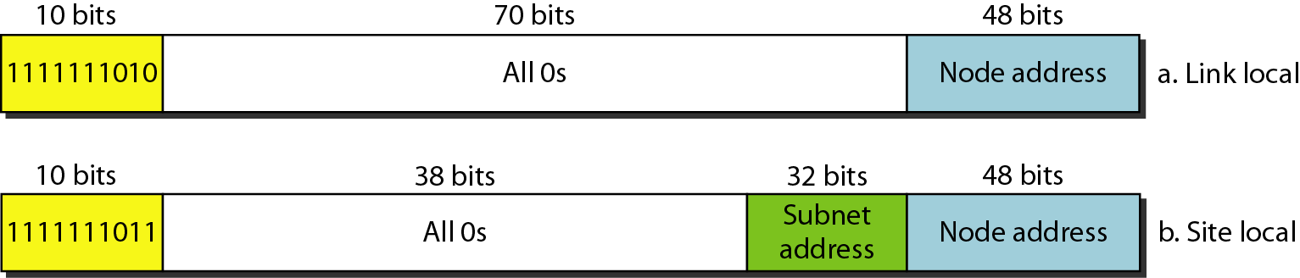
Figure 19.18 Reserved addresses in IPv6
Figure 19.19 Local addresses in IPv6

Slide 26
Routing Algorithms
Interior Gateway Protocols (IGP)
IGP is a type of protocols used by the routers in an autonomous system to exchange network reachability and routing information.
RIP
It is one of the most widely used IGP. This implements Distance Vector algorithm.
OSPF
It is also an IGP. This algorithm scales better than the vector distance algorithms

Slide 27
Routing Algorithms
RIP
RIP uses a hop count metric to measure the distance to a destination.
All routing updates are broadcast. This allows all hosts on the network to know about the routes.
To prevent routes from oscillating between two or more equal cost paths, RIP specifies that existing routes should be retained until a new route has strictly lower cost.
To prevent instabilities, RIP must use a low value for the maximum possible distance.
RIP uses 16 as the maximum hop count. This restricts the maximum network diameter of the system to 16.
RIP runs on top of TCP/IP.
RIP allows addresses to be of a maximum size of 14 Bytes.
The Distance varies from 1 to 16 (where 16 is used to signify infinity).
RIP address 0.0.0.0 denotes a default route.
There is no explicit size of the RIP message and any number of routes can be advertized.

Slide 28
Routing Algorithms
OSPF
OSPF includes type of service(ToS) routing. So, you can install multiple routers to a given destination, one for each type of service. When routing a datagram, a router running OSPF uses both the destination address and type of service fields in the IP Header to choose a route.
OSPF provides load balancing. If there are multiple routes to a given destination at the same cost, OSPF distributes traffic over all the routes equally.
OSPF allows for creation of AREA HIERARCHIES. This makes the growth of the network easier and makes the network at a site easier to manage.
OSPF protocol specifies that all exchanges between the routers be authenticated. OSPF allows variety of authentication schemes, and even allows one area to choose a different scheme from the other areas.
To accommodate multi-access networks like ethernet, OSPF allows every multi-access network to have a designated router (designated gateway).
To permit maximum flexibility, OSPF allows the description of a virtual network topology that abstracts away from details of physical connections.
OSPF also allows for routers to exchange routing information learned from other sites.
The message format distinguishes between information acquired from external sources and information acquired from routers interior to the site, so there is no ambiguity about the source or reliability of routes.

Slide 29
Routing Algorithms
Exterior Gateway Protocol (EGP)
EGP is used only to find network reachability and not for differentiating between good and bad routes.
We can only use distance metric to declare a route plausible and not for comparing it with some other route (unless the two route form part of a same autonomous system).
Since there cannot be two different routes to the same network, EGP restricts the topology of any internet to a tree structure in which a core system forms the root

Slide 30
Routing Algorithms
Border Gateway Protocol(BGP)
BGP is a distance-vector protocol used to communicate between different autonomous systems.
Instead of maintaining just the cost to each destination, each BGP router keeps track of the exact path used.
Every BGP router contains a module that examines routes to a given destination and scores them returning a number for destination to each route.
Any route violating a policy constraint automatically gets a score of infinity.
The router adapts a route with shortest distance
BGP easily solves the count to infinity problem that plagues other distance-vector algorithms as whole path is known.

Slide 31
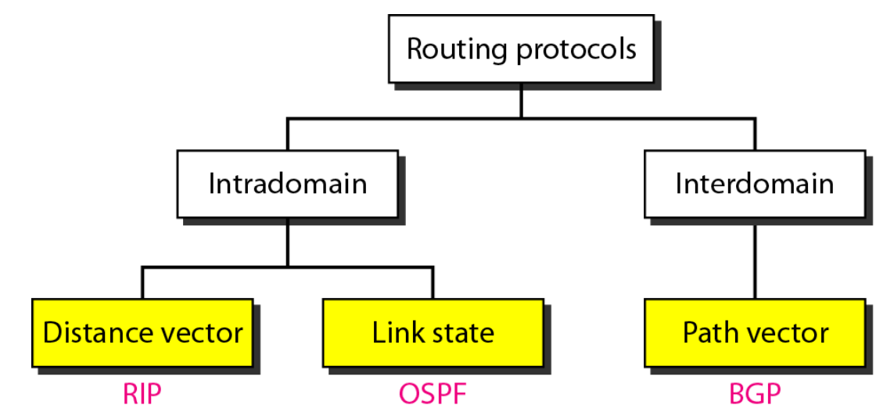

Slide 32
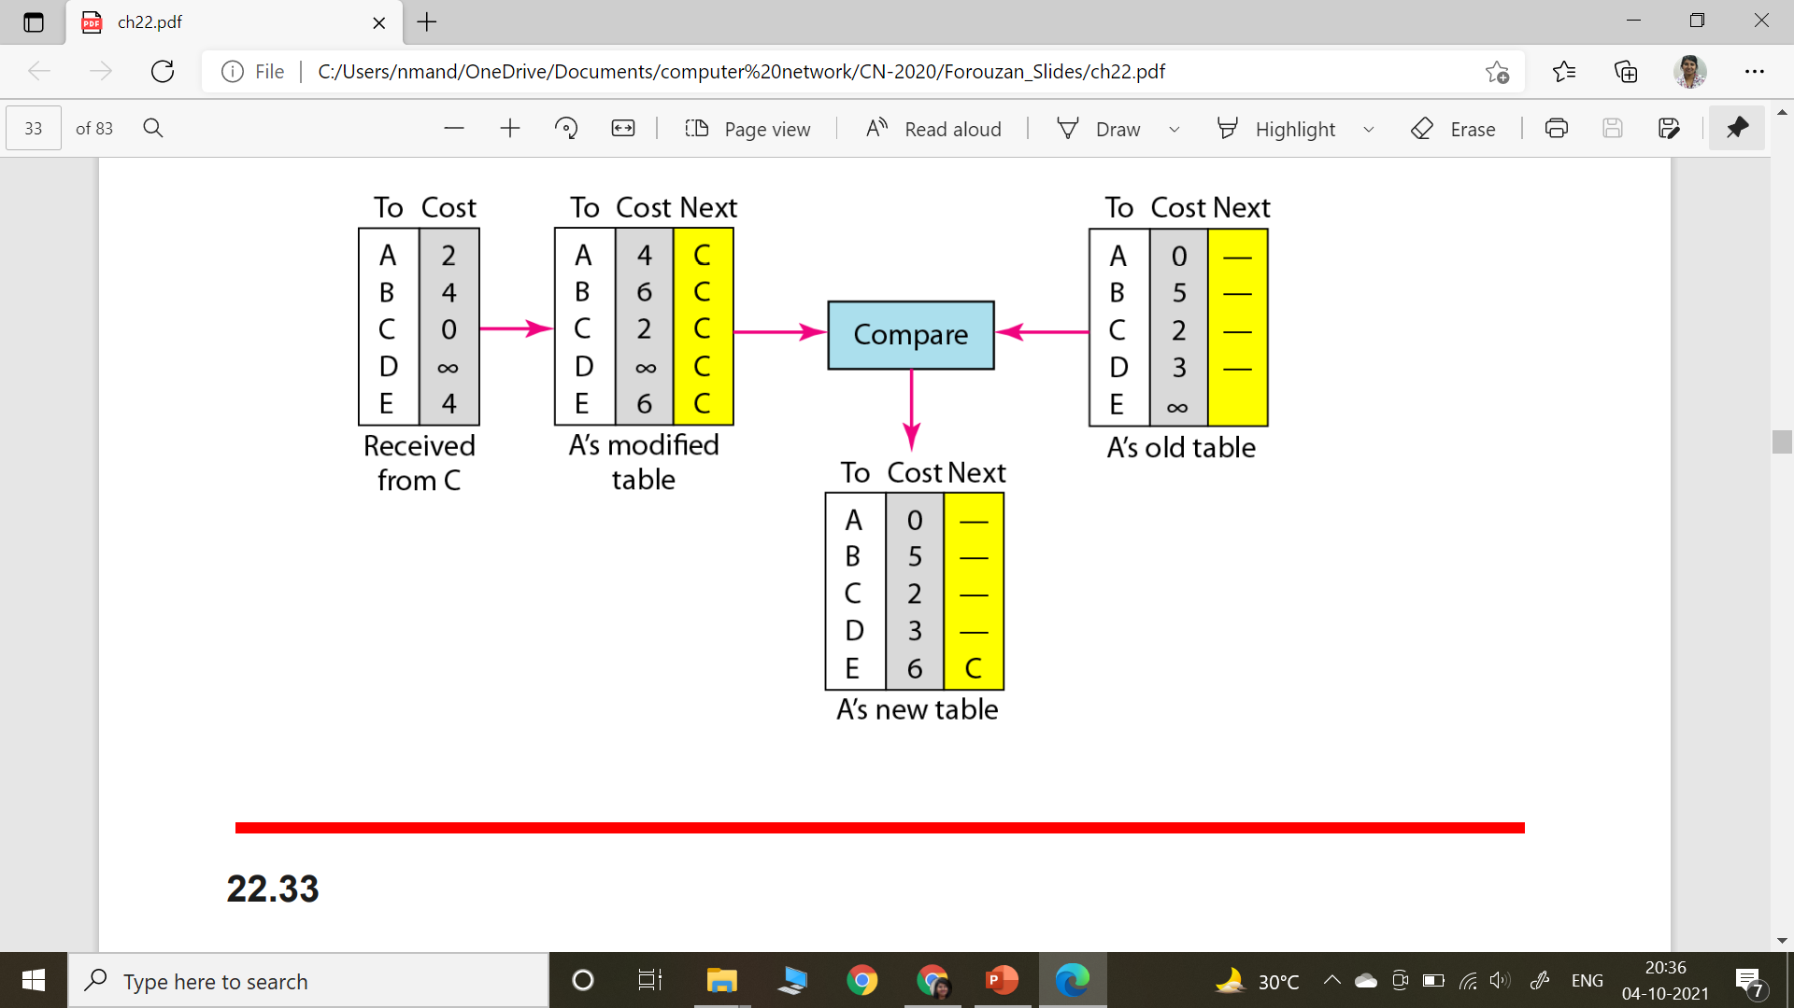
Distance Vector Routing
In distance vector routing, each node shares its routing table with its immediate neighbors periodically and when there is a change

Slide 33
Distance Vector Routing
Each router maintains a routing table containing entries of each router in the subnet
The entry contains two parts:
1) Preferred outgoing line to use for that destination 2) Estimate of time or distance to reach that destination
The metric used might be no. of hops, time delay in milliseconds, total number of packets queued along the path

Slide 34
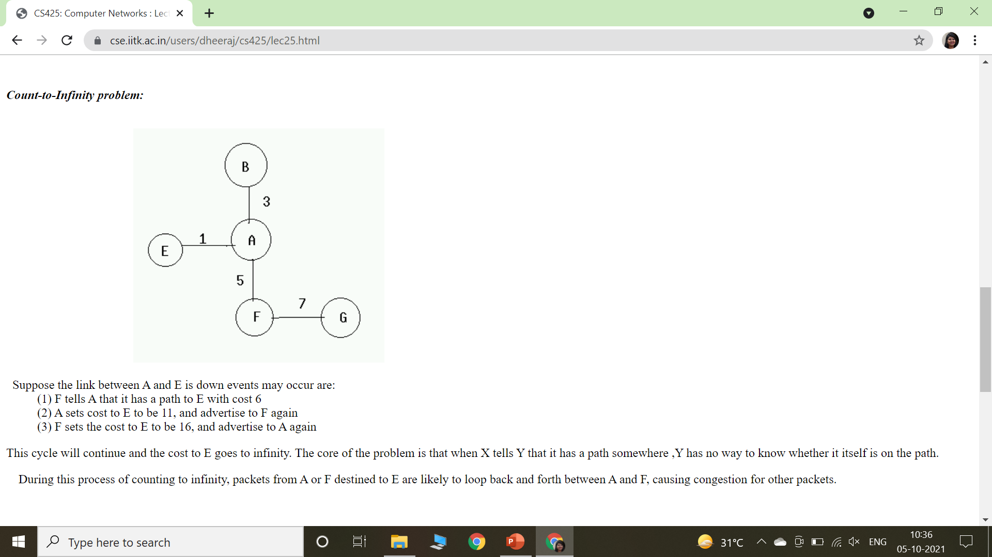
Distance Vector Routing
Count to Infinity Problem
Suppose the link between A and E is down events may occur are: (1) F tells A that it has a path to E with cost 6 (2) A sets cost to E to be 11, and advertise to F again (3) F sets the cost to E to be 16, and advertise to A again
This cycle will continue and the cost to E goes to infinity.
The core of the problem is that when X tells Y that it has a path somewhere ,Y has no way to know whether it itself is on the path.
During this process of counting to infinity, packets from A or F destined to E are likely to loop back and forth between A and F, causing congestion for other packets.

Slide 35
Distance Vector Routing
Problems of DVR
Count to Infinity Problem
Line Bandwidth was not taken into consideration while choosing routes

Slide 36
Link State Routing
Each Router must do the following:
Discover its neighbours and learn their network addresses
Measure the delay or cost to each of its neighbours
Construct a packet telling all it has just learned
Send this packet to all other routers
Compute the shortest path to every other router

Slide 37
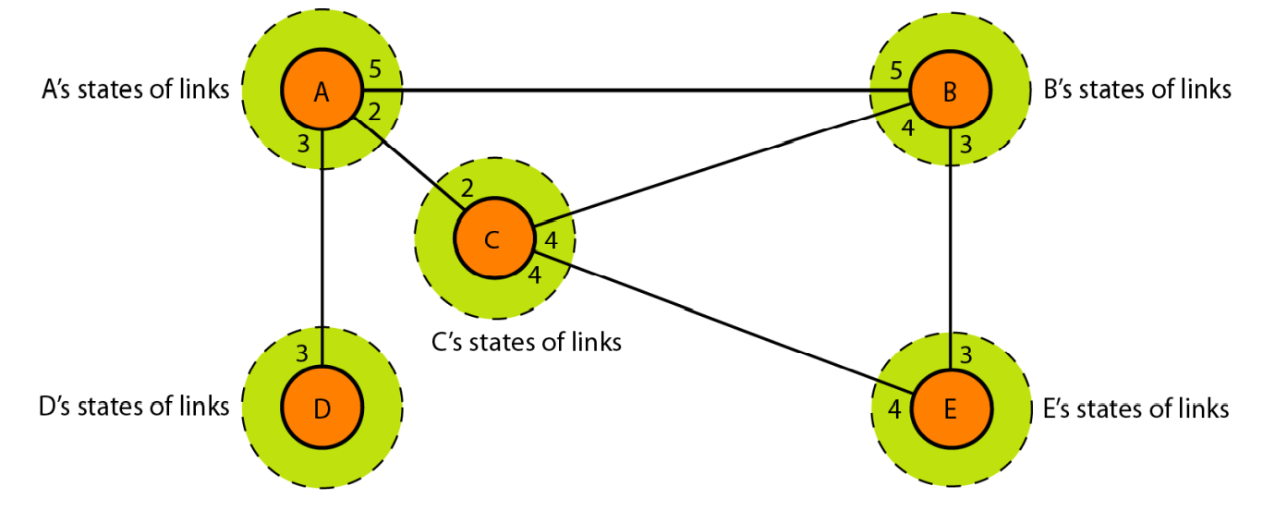
Link State Routing

Slide 38
Link State Routing

Slide 39
Link State Routing

Slide 40
Link State Routing

Slide 41
Link State Routing

Slide 42
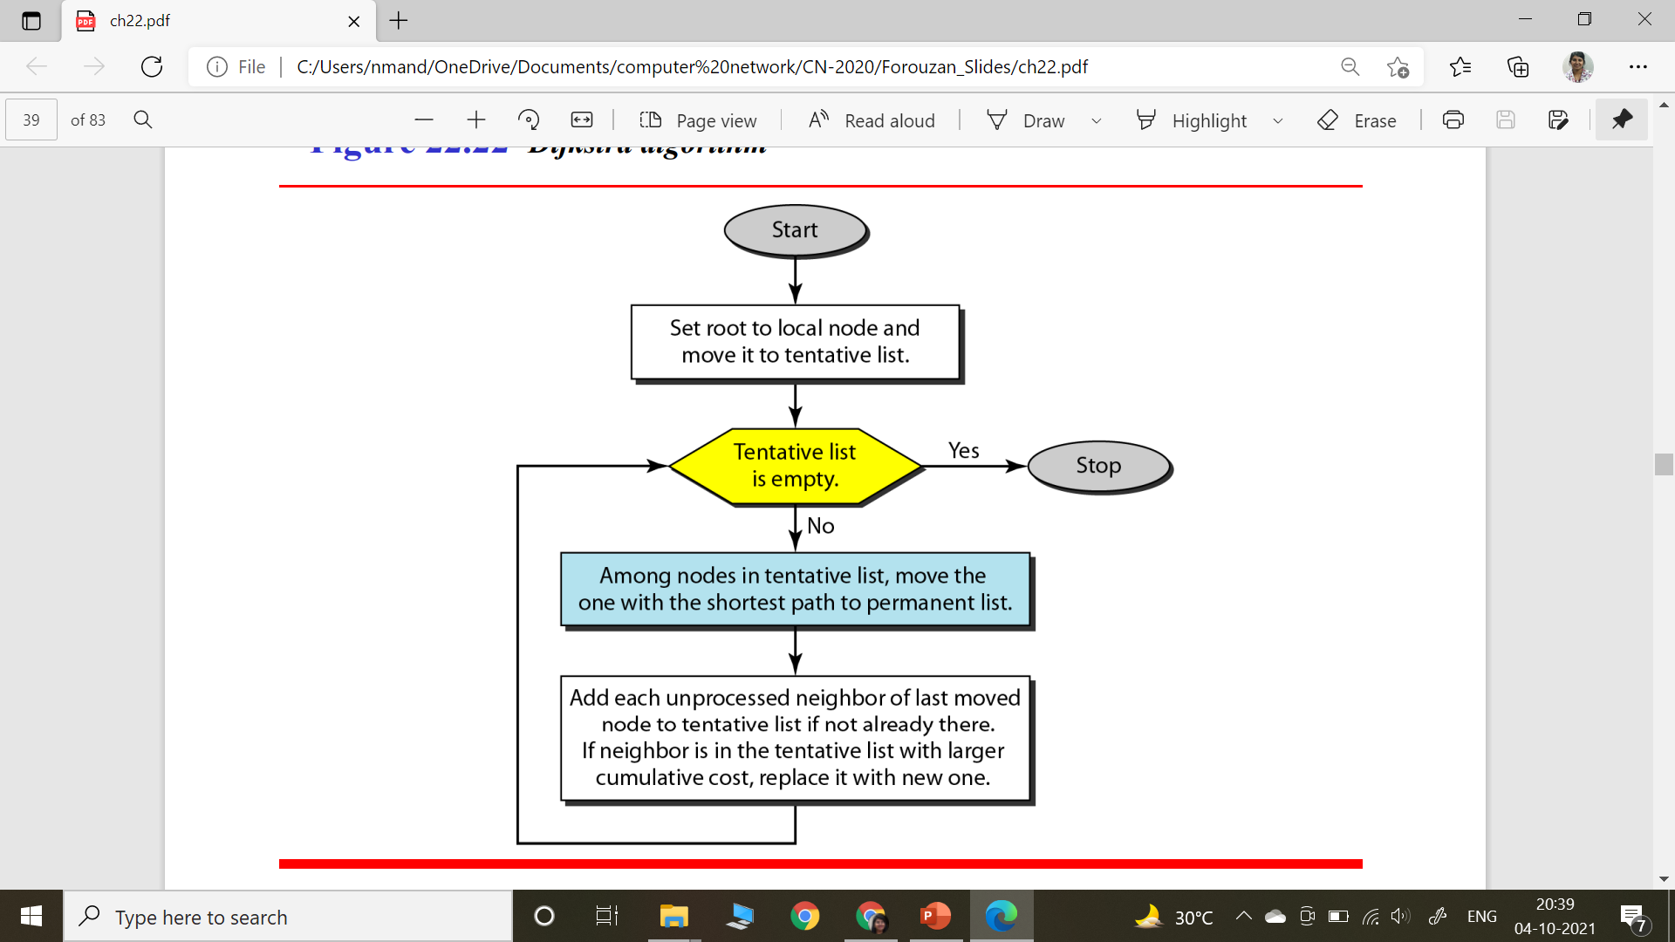
Dijkstra’s Algorithm
Shortest Path

Slide 43
Unicast Routing vs Multicast Routing
Unicasting
The router forwards the received packet through only one of its interfaces.
Each router in the domain has a table that defines a shortest path tree to possible destination
Multicasting
The router may forward the received packet through several of its interfaces
Each involved router needs to construct a shortest path tree for each group.

